Slide 1
PAREIDOLIA
Ever feel like you’re being watched?

Slide 2
Learning Intentions
To understand what ‘face pareidolia’ is.
To be able to identify some reasons why face pareidolia might happen
To be able to identify some of the uses it has for scientists and researchers.

Slide 3
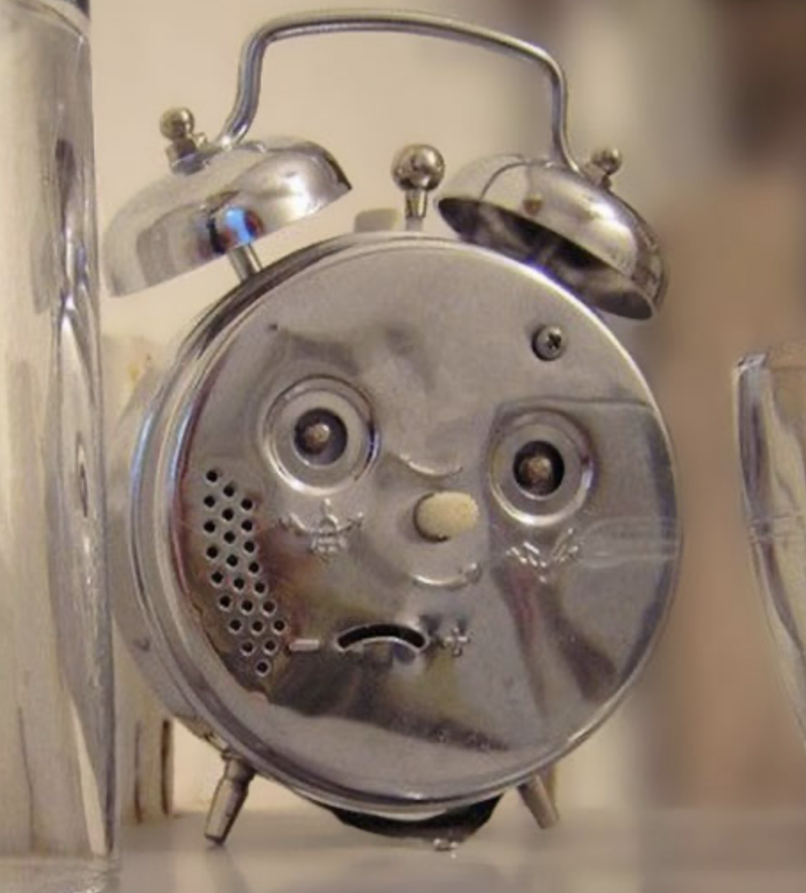
What is Pareidolia?
Do you notice anything about this photo of a clock?
If you thought that it looks sad, then you’re not alone!
Our brains are wired to be excellent at seeing, recognizing, and reading faces. They are so good at this that sometimes we see faces when there aren’t any!
When this happens, we call it ‘face pareidolia’
(pronounced PAR-AY-DOH-LEE-AH)
Image 1

Slide 4
Try it at home!
Take a look around your house or classroom for as many examples of pareidolia as you can!
You have 2 minutes – GO!

Slide 5
Why does pareidolia happen?
Now that you know what pareidolia is, you might be wondering why it happens!
There are many reasons why it might happen.
Psychologists and neuroscientists think it may be thanks to evolution, as pareidolia has been seen to happen to macaque monkeys too (who share common ancestors with humans).
Image 2

Slide 6
Why does pareidolia happen?
Being good at finding and reading faces is one of the most important things humans are able to do!
It helps us form relationships with people, spot faces in a crowd, and it allows us to understand what a person is thinking or feeling by using non verbal cues
(like eye contact, gaze direction, or facial expressions)

Slide 7
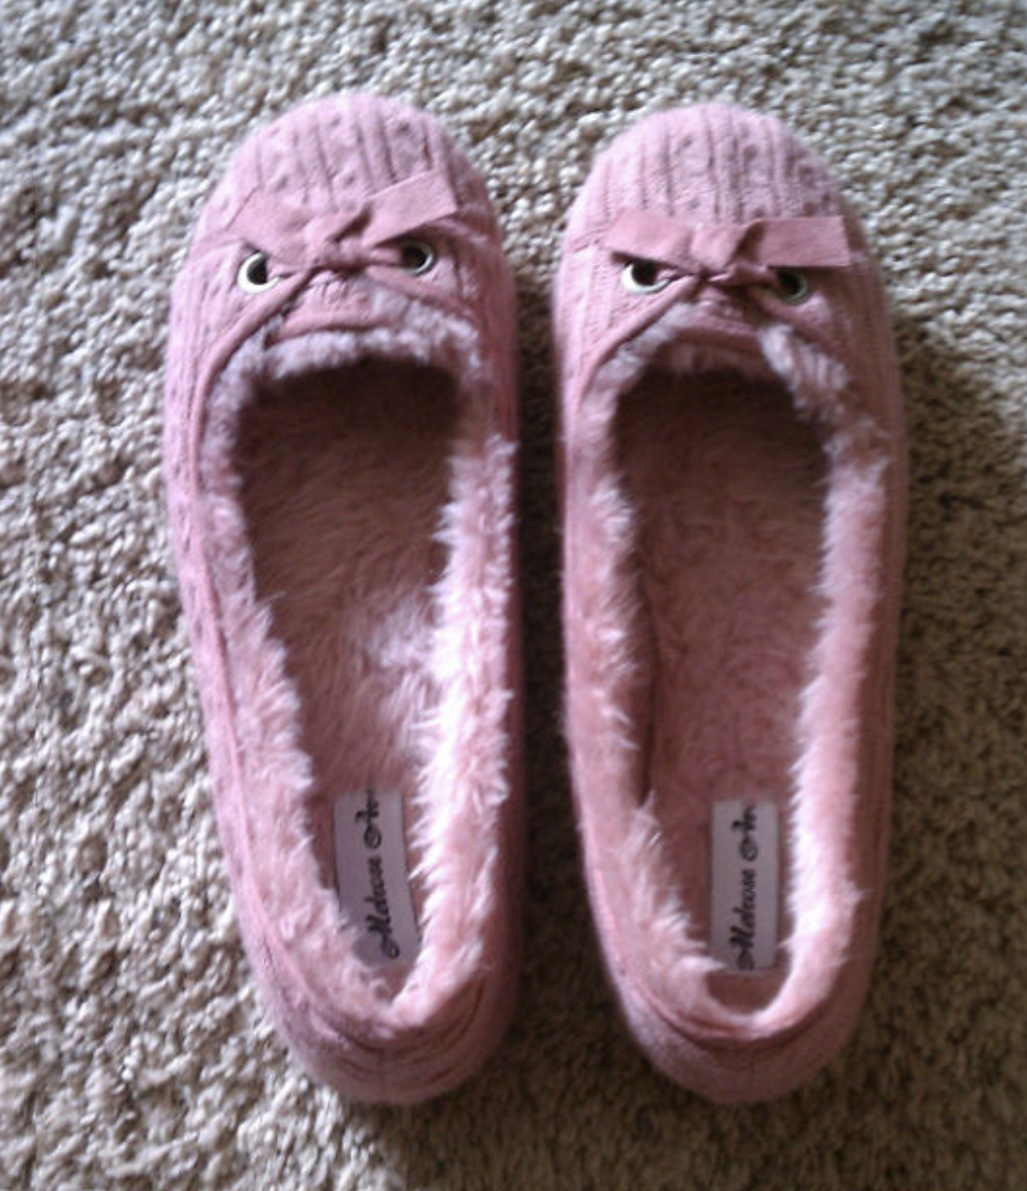
What is it useful for?
Studying pareidolia helps psychologists and neuroscientists understand more about how we perceive faces
There are some people who aren’t great at face perception (autistic people, for example).
So for scientists, understanding pareidolia helps them to understand why some people struggle with reading and understanding faces!
Image 3

Slide 8
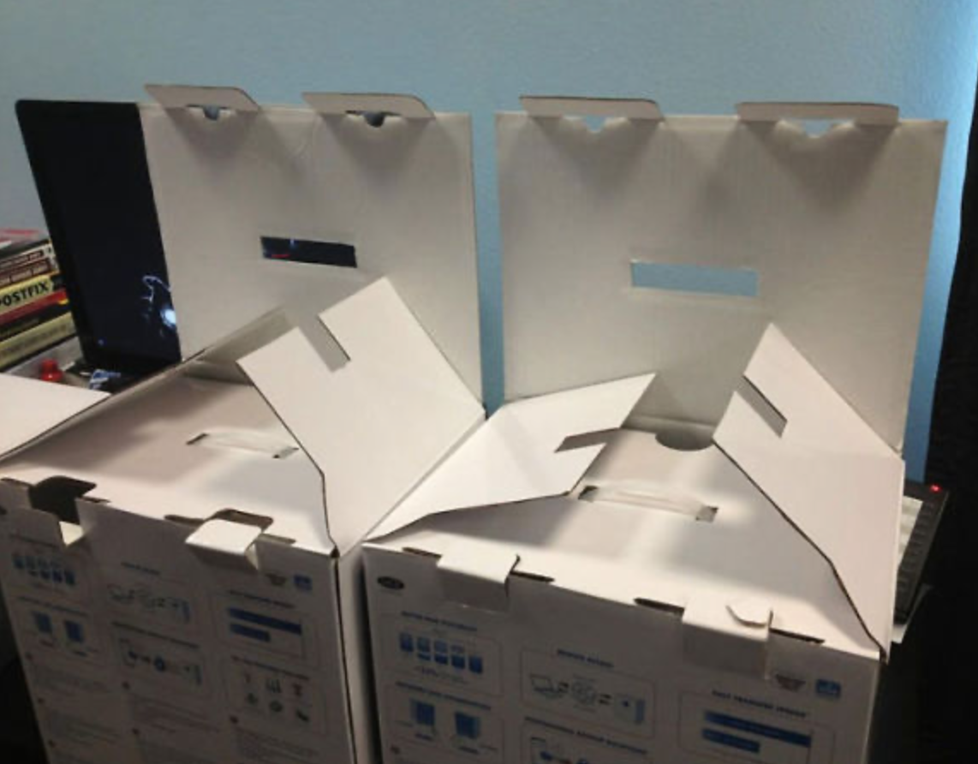
What is it useful for?
Recent research has shown that we recognise people’s eyes and mouths better than anything else on their face!
Can you think of why this might be?
What might this be useful for? (hint… look at the background of the powerpoint…)
Image 4

Slide 9
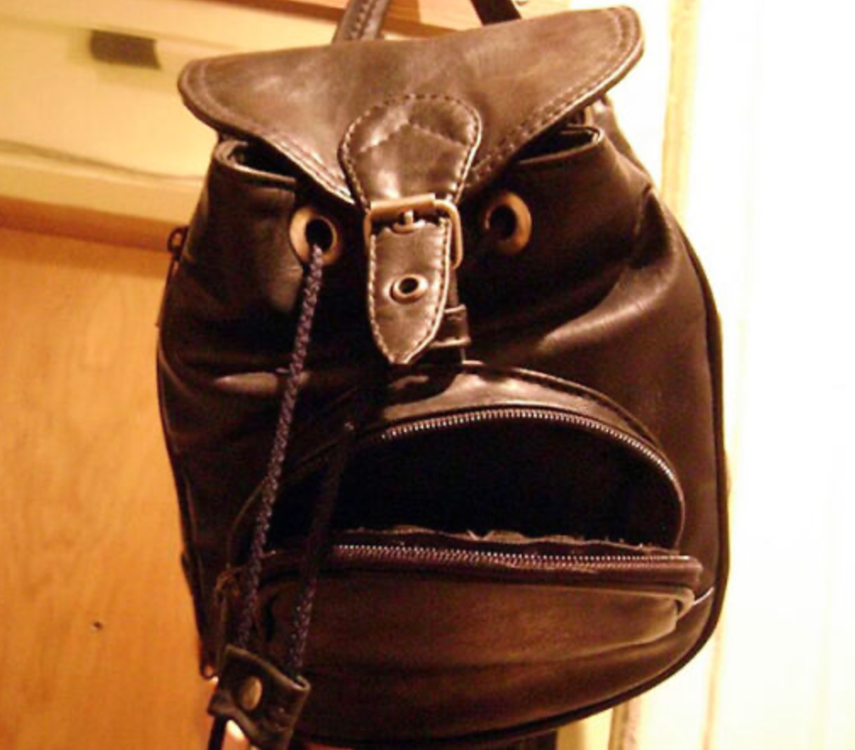
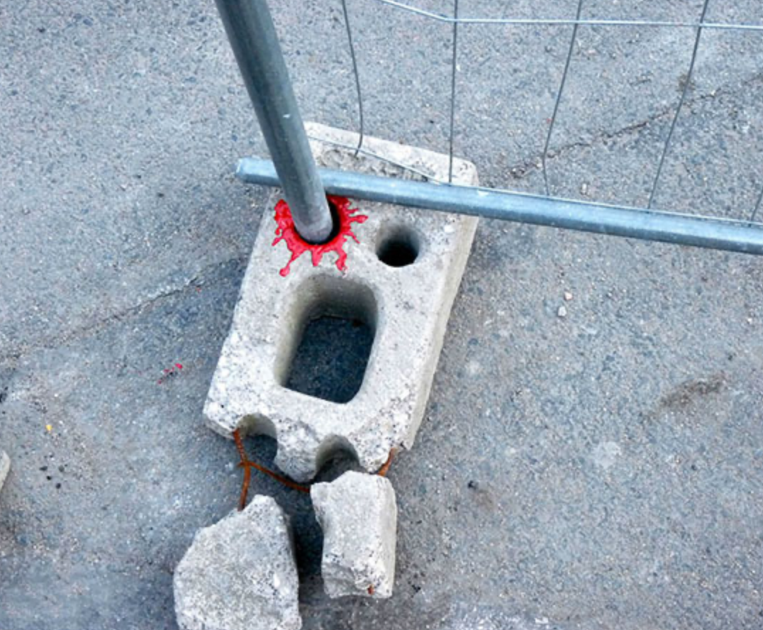
Guess the emotion!
Can you guess which emotion each of these objects are expressing?
Image 5
Joy
Image 6
Image 7
Anger
Pain

Slide 10
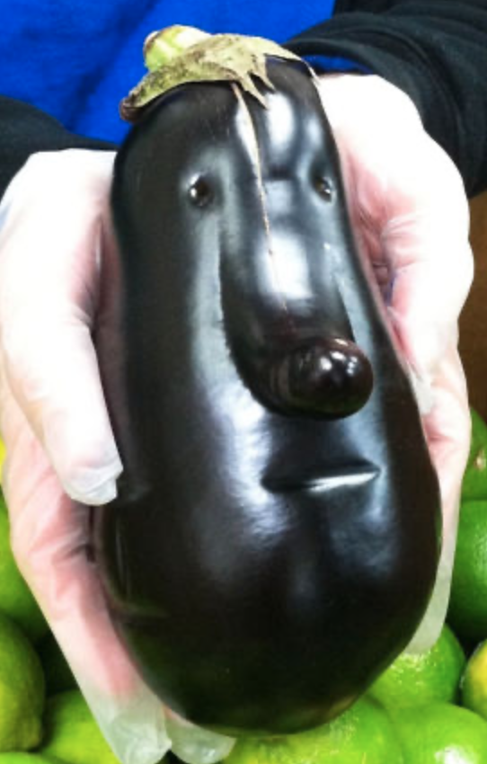
Faces and Emotion
When we’re looking at someone’s face, often we need a little bit more information. We need to know whether they are paying attention to us, how they are feeling, or who they are!
Scientists use a technique called fMRI (functional Magnetic Resonance Imaging) which takes a scan of where the blood flows in the brain when we’re looking at these ‘pareidolia’ objects.
They found that the same part of the brain is activated when we’re reading from both human and ‘pareidolia’ faces!
Image 9

Slide 11
In Summary
We have learnt that pareidolia is a function of the brain that makes us see faces in objects where there aren’t any
We can identify some of the reasons why pareidolia happens. For example, we have evolved to be really good at spotting predators.
We can identify some of the things that make pareidolia useful for scientists. For example, understanding why autistic people struggle with face perception.

Slide 12
Try it at home!
(optional)
Using water, lots of soap, and some food colouring try to create your own patterns that resemble faces!
OR
Get some paper, paints, and a paint brush and create splatters on the page, then fold the paper. Unfold and think about what it looks like!
Have fun! 😃

